Slide 1




TABLEAU
Federal Aviation Administration Wildlife Strikes dataset for the year 2015

Slide 2



Introduction
Project Focus
This project focuses on analyzing the FAA Wildlife Strikes dataset for the year 2015, aiming to understand its financial implications and uncover patterns related to wildlife strikes in aviation. The analysis is conducted using Tableau to create visualizations and address specific questions related to the dataset.

Slide 3
Project Objective
The primary objective of this analysis is to thoroughly examine the FAA Wildlife Strikes dataset for the year 2015 and assess its financial implications. This involves the following key tasks:
Develop Visualizations:
Identify Patterns and Trends:
Build Interactive Dashboard:

Slide 4
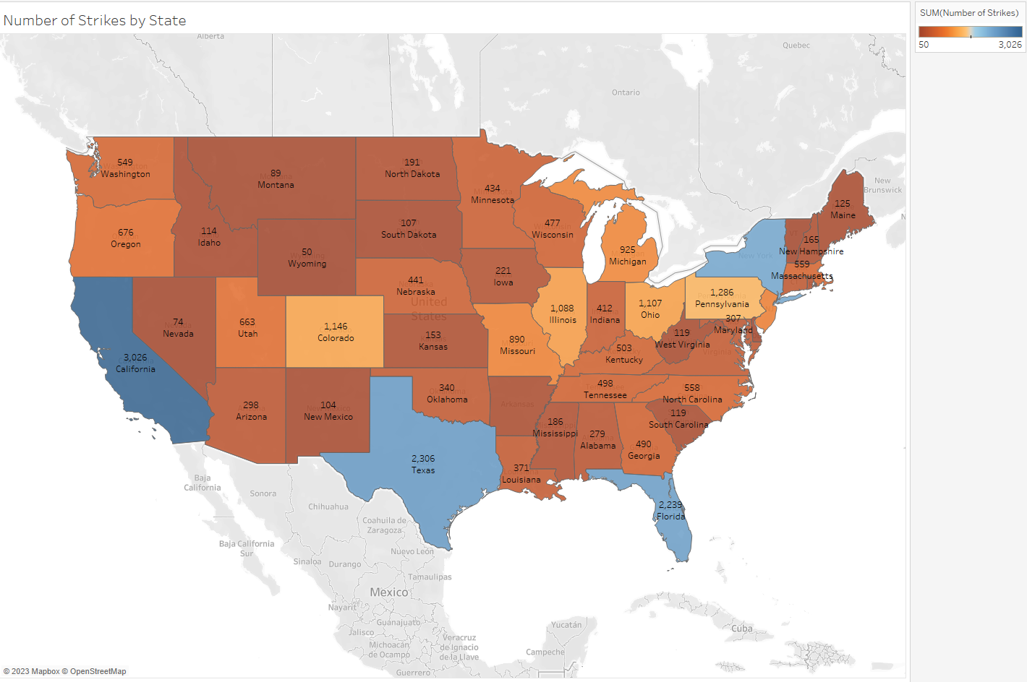
fetch location data from Foursquare API
Critical Questions Addressed
State Incidence: Which states experienced higher incidences of wildlife strikes?
1- California 2-Texas 3-Florida 4-New York

Slide 5
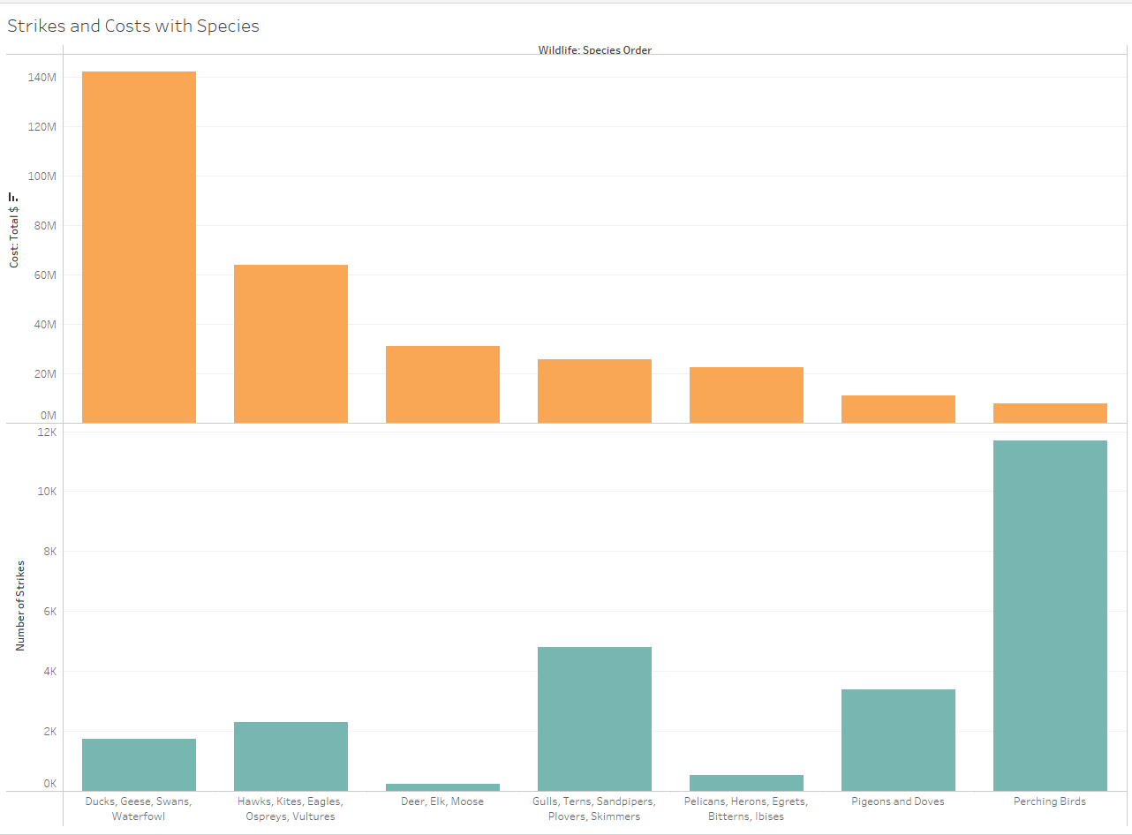
fetch location data from Foursquare API
Critical Questions Addressed
Species Impact and Cost: What are the most affected animal species, and what are the associated costs?
1-Most hits from birds but least cost
2-Most cost from Ducks, geese

Slide 6
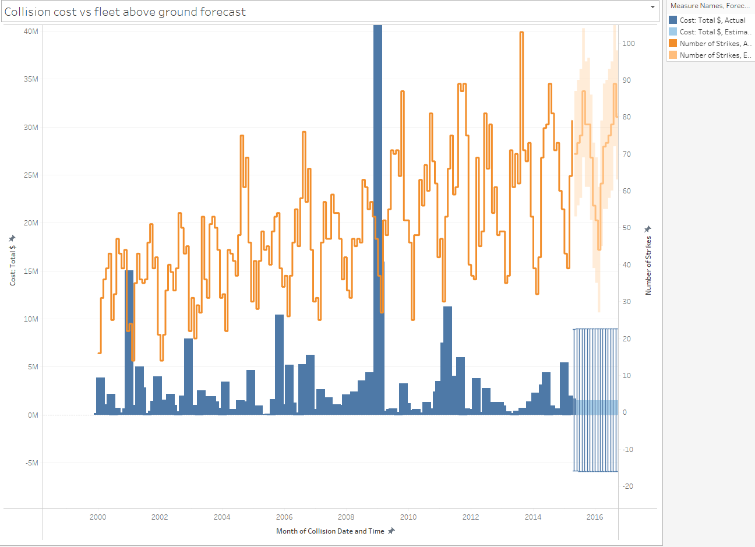
fetch location data from Foursquare API
Critical Questions Addressed
State-Specific Costs: How does the cost of these strikes vary by state?
what can we forecast for the future?
1-Jan 2009 strange high strikes but cost is not very high
2-forecost say rising trends due to increase number of flights but cost stays linear.

Slide 7
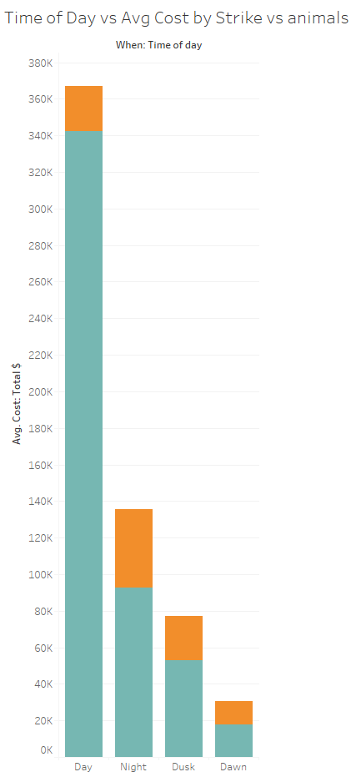

fetch location data from Foursquare API
Critical Questions Addressed
Incident Frequency by Time: How do wildlife strike incidents vary in frequency at different times of the day?
1- Day time the terrestrial mammals are at most strikes
2- Nighttime birds are increased a bit as compared to the day.

Slide 8
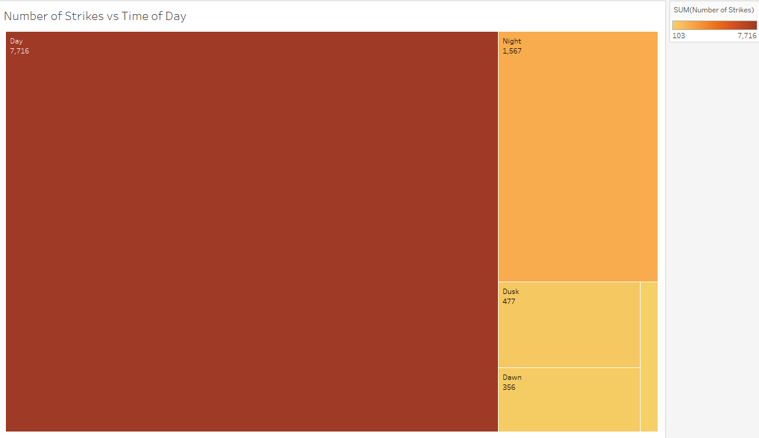
fetch location data from Foursquare API
Critical Questions Addressed
Incident Frequency by Time: How do wildlife strike incidents vary in frequency at different times of the day?
1- Day time the frequency is high due to animals are awake
2- least at dawn

Slide 9
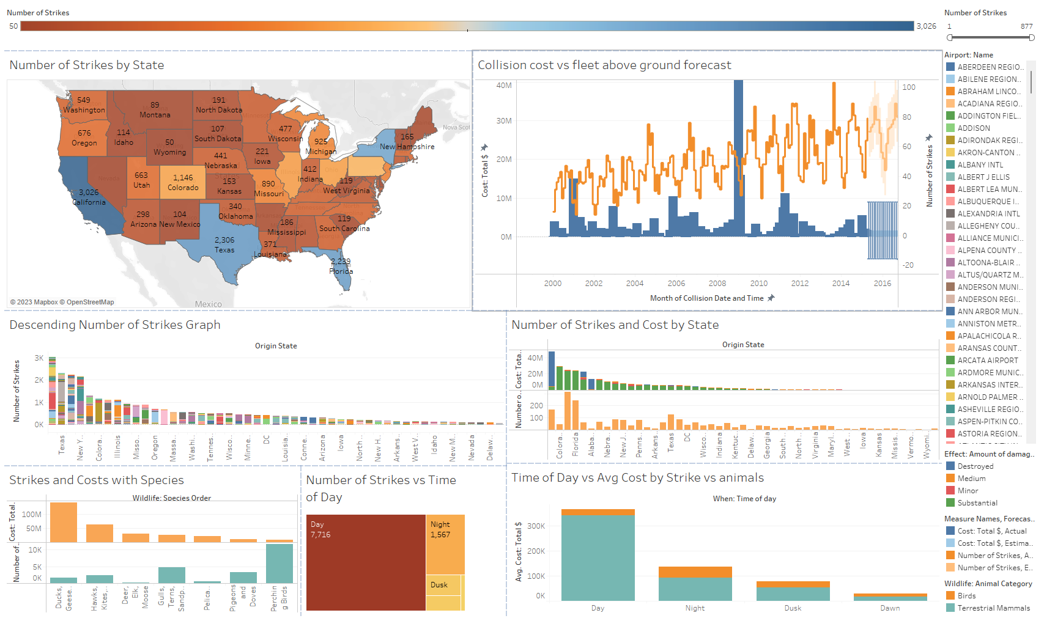
fetch location data from Foursquare API
Dashboard

Slide 10
Challenges
Initially, one of the primary challenges I faced was the organization and formulation of meaningful questions to guide my analysis effectively.
Additionally, a desire to categorize airports into international, private, and commercial segments emerged as a challenge, which could have provided further insights into the dataset.

Slide 11

Time
Enhancing the creation of additional data-related graphics.
Crafting a compelling narrative to narrate the data's significance and findings, providing a more comprehensive understanding of the analysis.

Slide 12


THANK YOU
BY Ahmad Furqan

